Slide 1
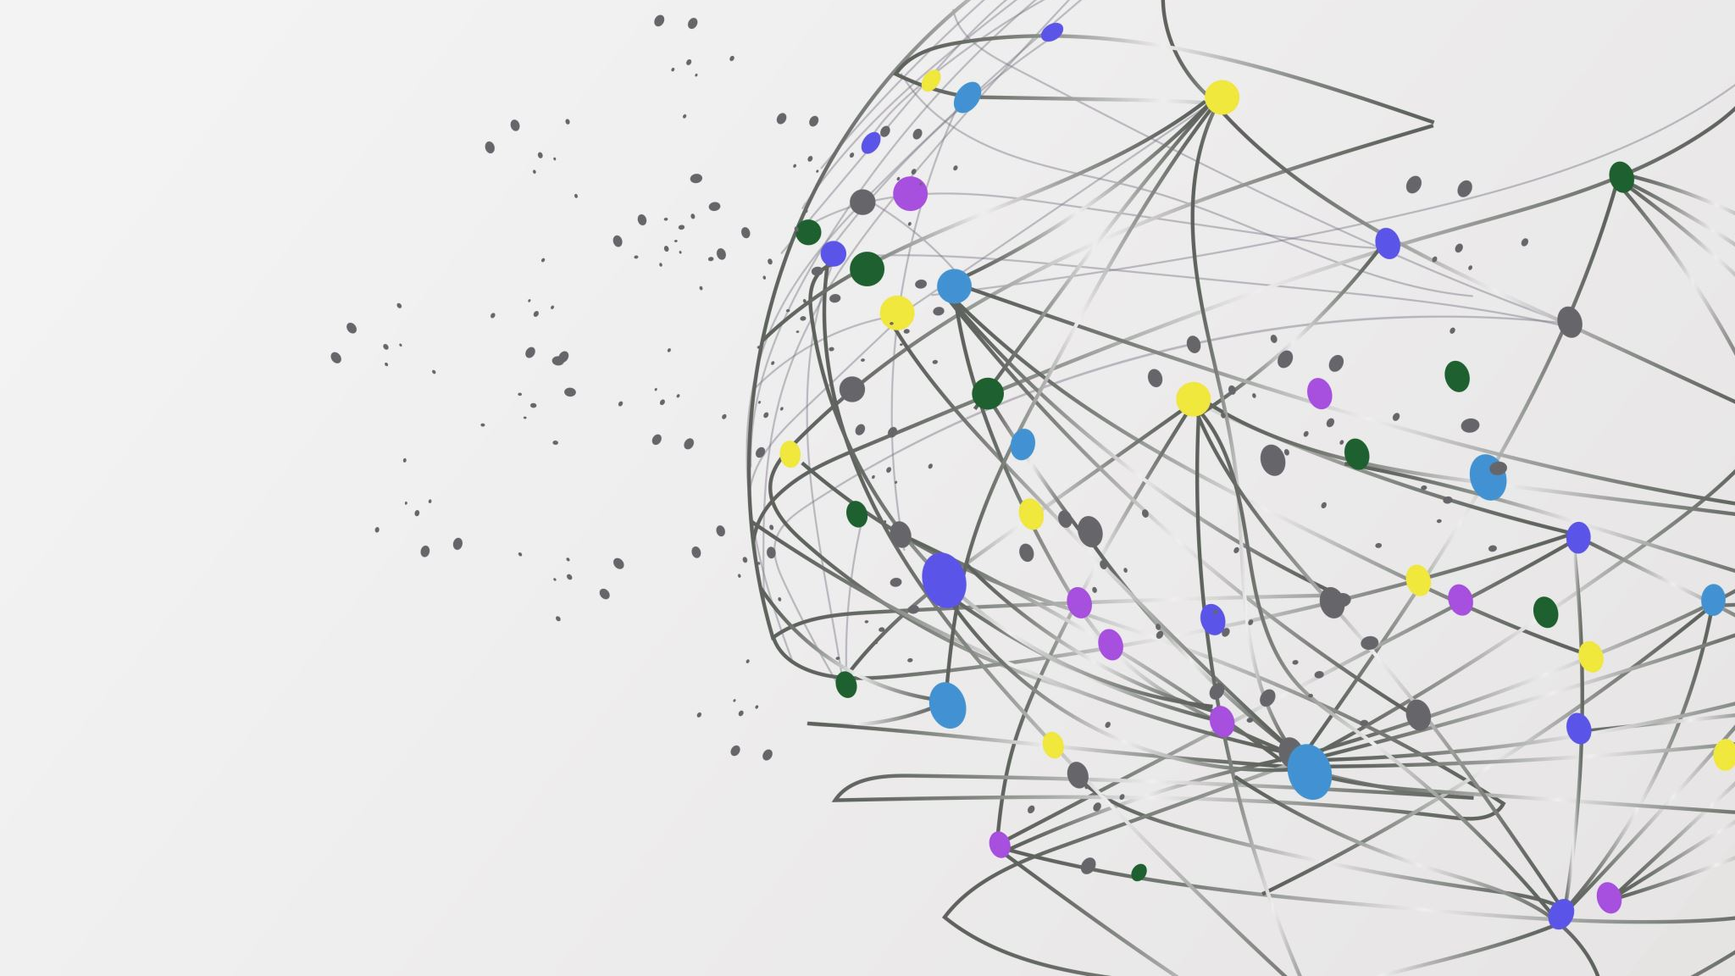
Study of LSTM applicability: Weather and Stock prediction
Prepared By
Arijit Dey(01944575)
Advisor
Prof. Iren todorova valova

Slide 2
Outline
Terminologies
Introduction to the Study
LSTM Network Architecture
Experiments
Results
Conclusions
Questions

Slide 3
Terminologies
DNN : Deep Neural Networks
RNN : Recurrent Neural Networks
LSTM : Long Short-Term Memory Networks

Slide 4
Introduction to the Study
Long Short-Term Memory (LSTM) networks are a type of recurrent neural network capable of learning order dependence in sequence prediction problems. This is a behavior required in complex problem domains like machine translation, speech recognition, stock ,weather predictions and more.
This is important in our case because the previous price of a stock is crucial in predicting its future price.
The same rule applies on predicting weather temperature of future using the past data.
Our study will be confined to LSTM networks on predicting above topics.

Slide 5
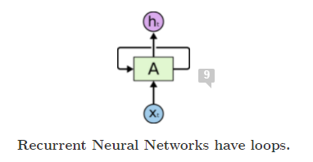
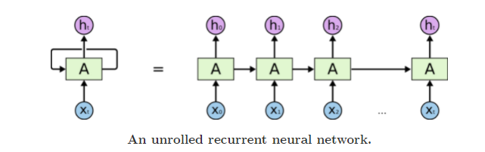
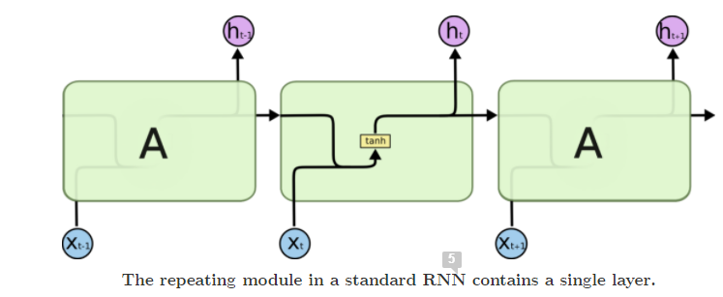
RNN Network Architecture

Slide 6
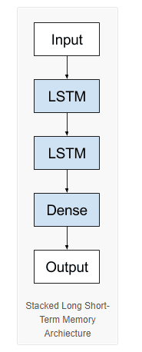
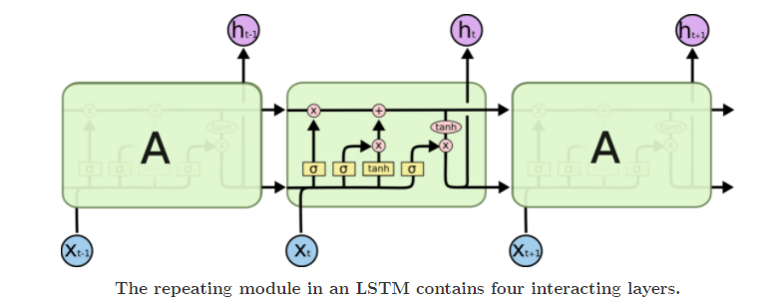
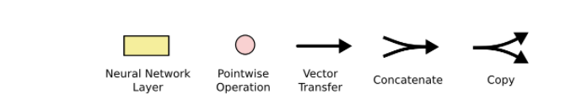
LSTM Network Architecture

Slide 7
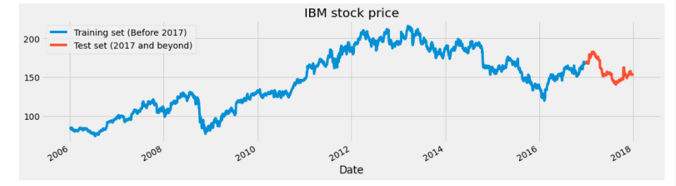
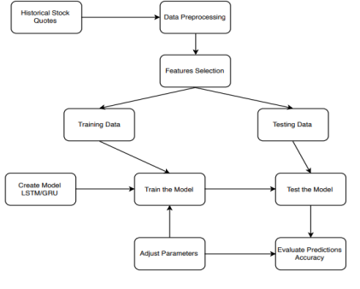
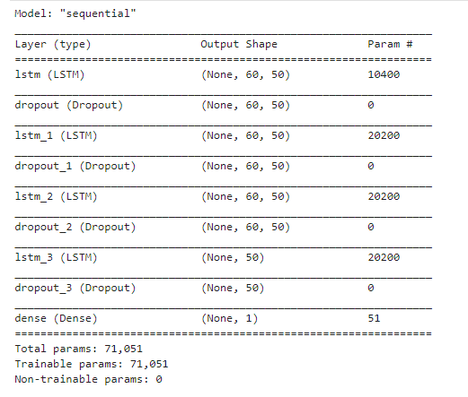
Experiments (Stock Prediction)

Slide 8
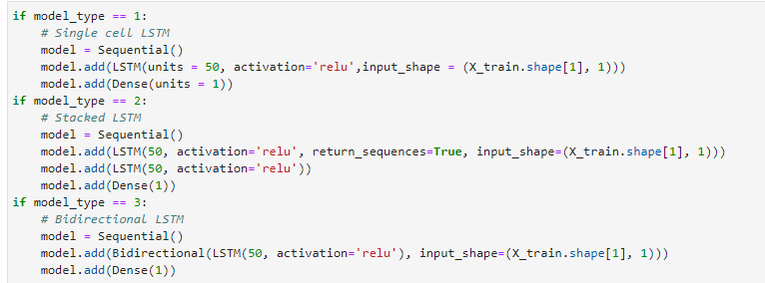
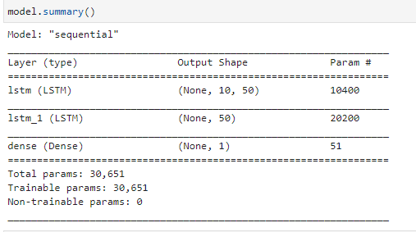
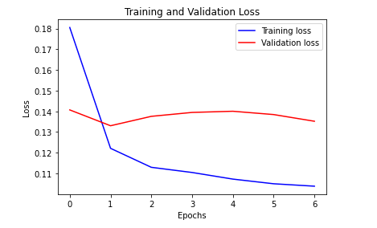
Experiments (Weather Prediction)

Slide 9
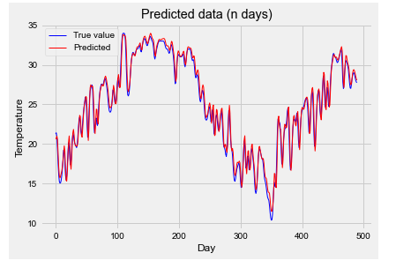
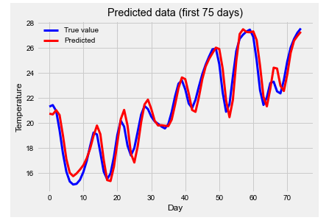
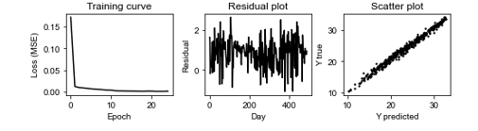
Results and Discussion (Weather)

Slide 10
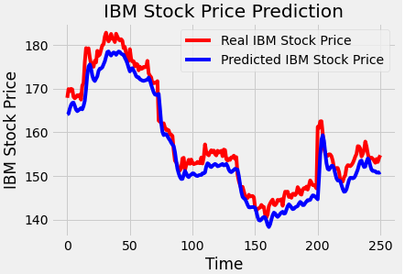
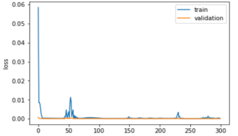
Results and Discussion (Stock)

Slide 11
Conclusion
Increase or decrease the number of epochs to define the number times that the learning algorithm will work through the entire training dataset.
One of the best ways is to use a large dataset and train the model, but this might take a longer time. You can use GPUs with Kera’s by installing CUDA.
Add more LSTM layers.

Slide 12
Questions?

